Slide 1
Alzheimer's Disease Detection Using MRI
GROUP 19

Slide 4
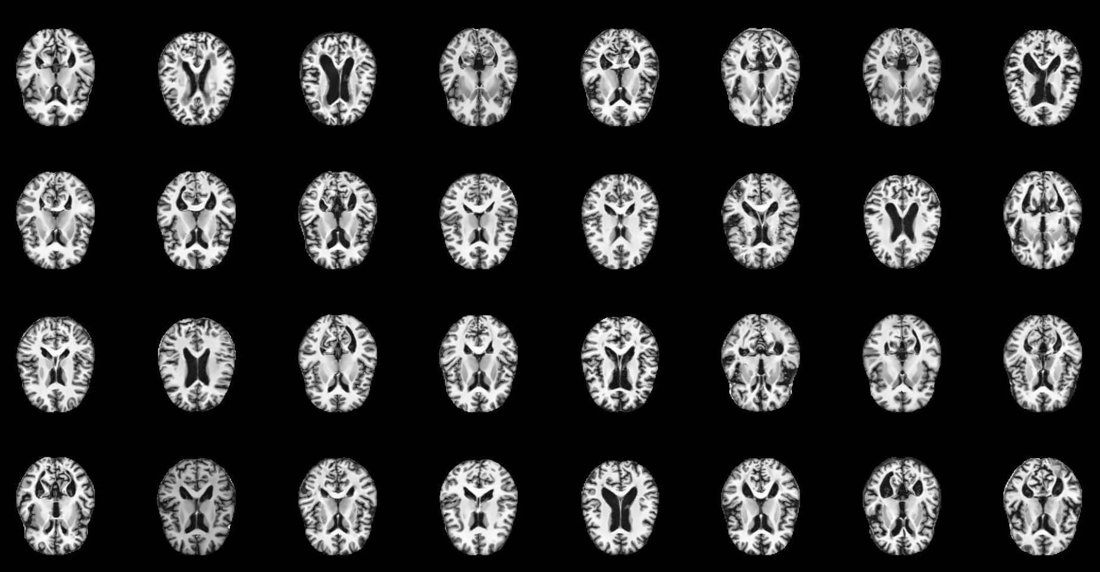
Dataset
Notes:
Thanks, Jisoo. Now, let’s get to the dataset. The dataset we have contains MRI images of patients’ brains. Each image represents one patient.

Slide 5
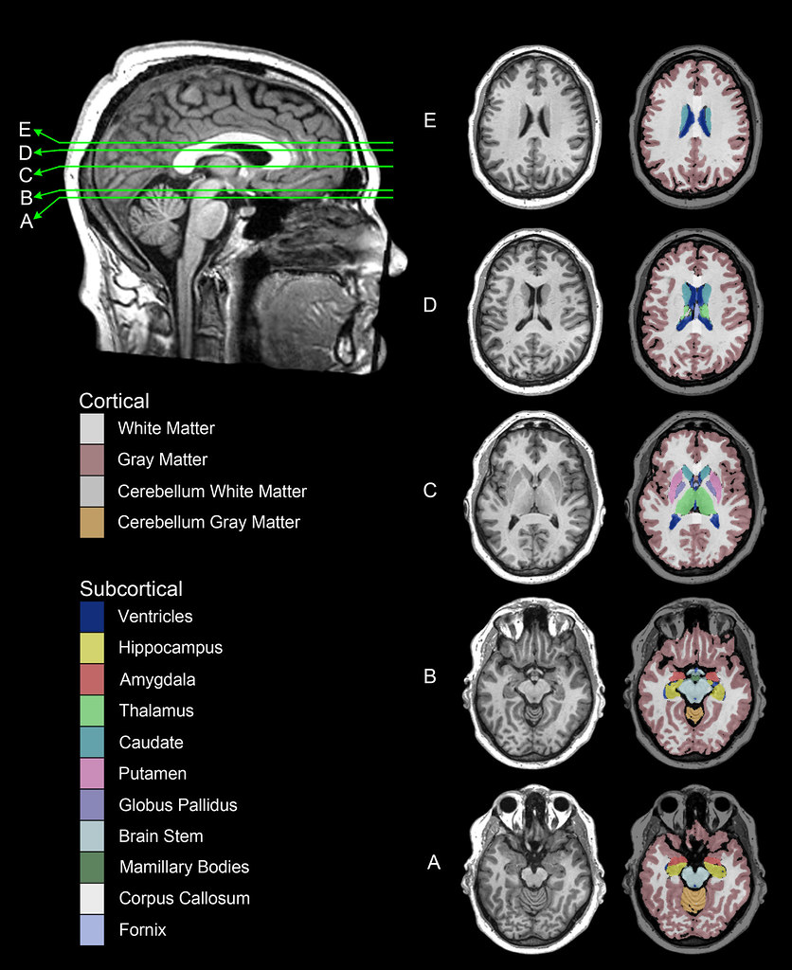
Dataset
Notes:
The MRI images may look very different because they are from different slices of the head. Some were cut above the midbrain, and some were cut below.

Slide 6
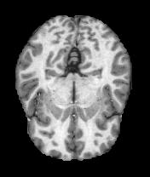

Preprocessing
Contrast enhancement
Denoising
Intensity normalization
Binarization
Notes:
To effectively detect Alzheimer's disease, image preprocessing is crucial. As Alzheimer's disease is linked to specific brain changes, many of which are structural, preprocessing aims to enhance the model's ability to identify these changes.

Slide 7
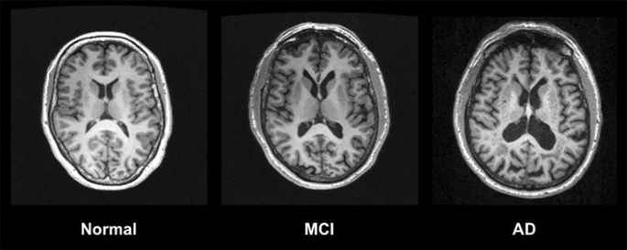
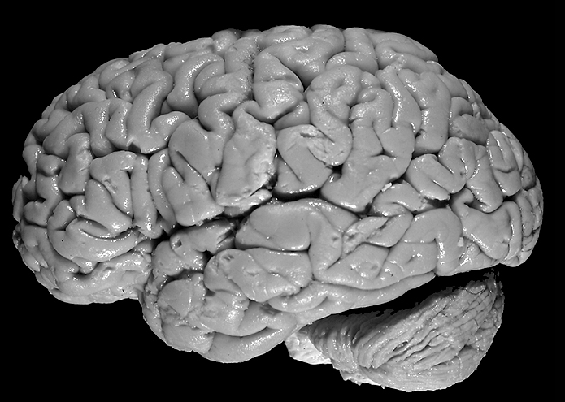
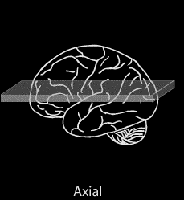
Imaging of the Brain
Front
Front
Notes:
Before getting to steps, let’s talk about the MRI images of brains. The images in our dataset are called axial cross-sections, which means you make cuts like this to see the internal structure of the brain.

Slide 8
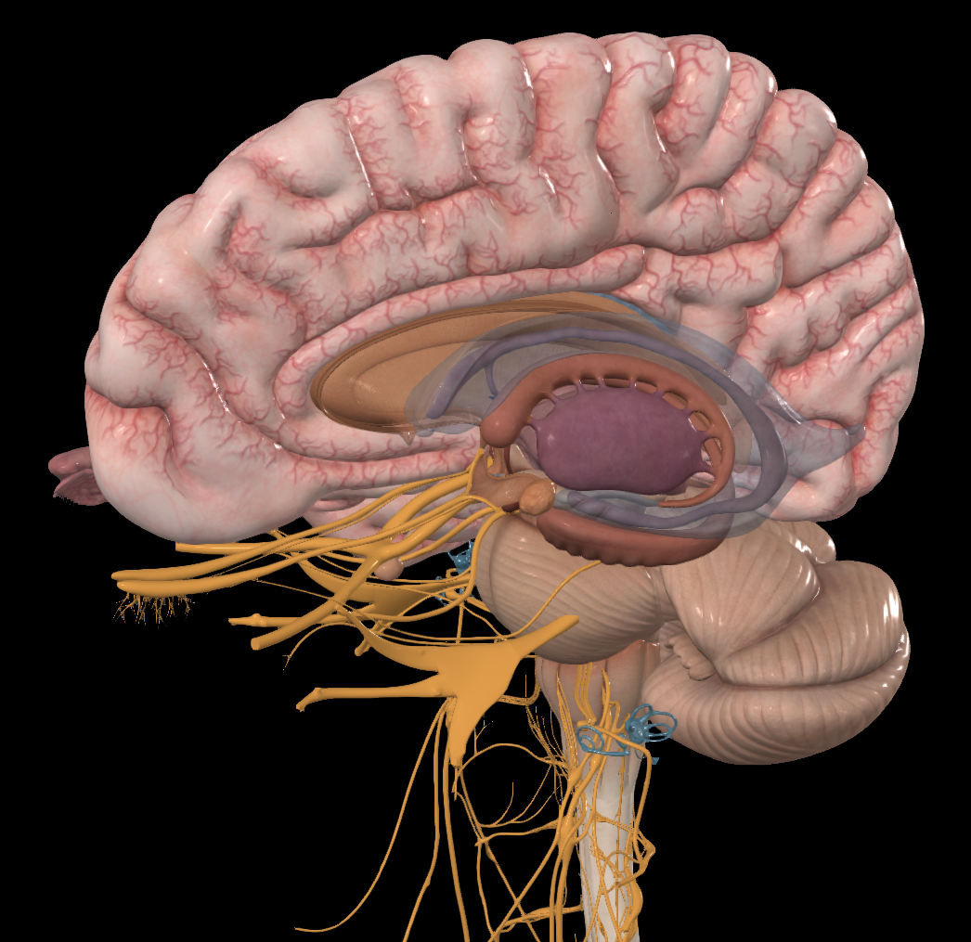
Morphological Changes in the Brain
Front
Sulci
Lateral Ventricle
Front
Hippocampus
Notes:
For people who have Alzheimer‘s, the shape of their brains changes. As more neurons die, many parts of the brain begin to shrink. This is called atrophy. The first part to suffer is the medial temporal lobe structures, such as the hippocampus, which plays an important role in learning and memory. As neurons die, the hippocampus gets smaller. And this is why people with Alzheimer‘s have a very short memory and have difficulties in learning new things.
█ There is a cavity inside the brain and it is depicted as a blue translucent part in the image to the left. That is called the lateral ventricle. It is a compartment filled with cerebrospinal fluid. As the hippocampus and other structures nearby shrink, this compartment becomes larger. So, in the MRI image, you will see an increased area of the lateral ventricle.
█ As time goes by, the toxic proteins will spread to all parts of the brain and kill neurons, causing the whole brain to shrink. At that time, the sulci, which are the grooves between folds, will be widened. Now, let’s look at an example.

Slide 9
Morphological Changes in the Brain
Front
Front
Notes:
For people who have Alzheimer‘s, the shape of their brains changes. As more neurons die, many parts of the brain begin to shrink. This is called atrophy. The first part to suffer is the medial temporal lobe structures, such as the hippocampus, which plays an important role in learning and memory. As neurons die, the hippocampus gets smaller. And this is why people with Alzheimer‘s have a very short memory and have difficulties in learning new things.
█ There is a cavity inside the brain and it is depicted as a blue translucent part in the image to the left. That is called the lateral ventricle. It is a compartment filled with cerebrospinal fluid. As the hippocampus and other structures nearby shrink, this compartment becomes larger. So, in the MRI image, you will see an increased area of the lateral ventricle.
█ As time goes by, the toxic proteins will spread to all parts of the brain and kill neurons, causing the whole brain to shrink. At that time, the sulci, which are the grooves between folds, will be widened. Now, let’s look at an example.

Slide 10
Morphological Changes in the Brain
Front
Front
Notes:
The image to the left is a normal brain. The one to the right has severe Alzheimer‘s. It’s clear to see that the ventricles in the one with Alzheimer’s are enlarged, and the sulci have been widened significantly. By using preprocessing, we hope we can make these structural changes more obvious and thus help improve the model’s accuracy.

Slide 11
Morphological Changes in the Brain
Front
Sulci
Lateral Ventricle
Front
Notes:
The image to the left is a normal brain. The one to the right has severe Alzheimer‘s. It’s clear to see that the ventricles in the one with Alzheimer’s are enlarged, and the sulci have been widened significantly. By using preprocessing, we hope we can make these structural changes more obvious and thus help improve the model’s accuracy.

Slide 12
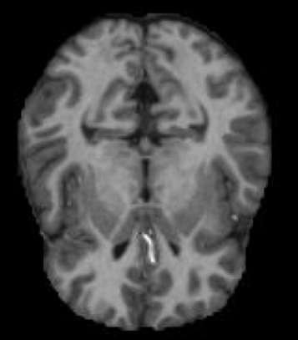
Preprocessing – Contrast Enhancement
Original Image
Notes:
The next step we took was contrast enhancement. This helps emphasize the differences between brain regions, making it easier for the model to detect atrophy and other disease-related changes.

Slide 13
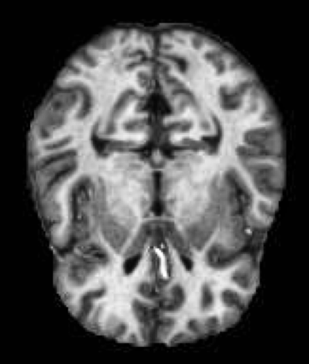
Preprocessing – Contrast Enhancement
Original Image
Contrast Adjustment
Notes:
The next step we took was contrast enhancement. This helps emphasize the differences between brain regions, making it easier for the model to detect atrophy and other disease-related changes.

Slide 14
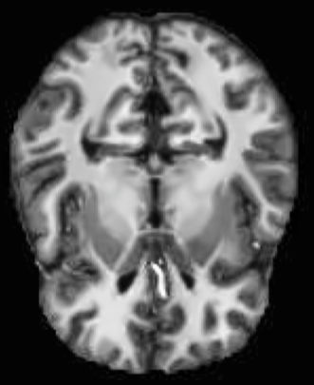
Preprocessing – Denoising
Original Image
Contrast Adjustment
Denoising
Notes:
Next, we applied denoising to the images to remove unwanted noise while preserving important details, which helps in the separation of brain fluids from white matter. This is important to identify the size of the ventricles.

Slide 15
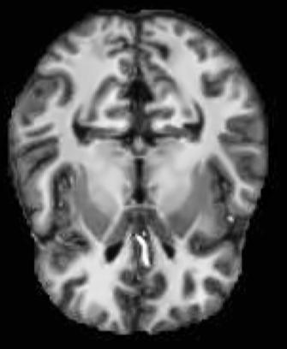
Preprocessing – Intensity Normalizing
Original Image
Contrast Adjustment
Denoising
Normalizing Intensity
Notes:
And finally, we normalize the intensity to ensure consistent intensity levels across images, enabling accurate feature extraction and comparison.

Slide 16
Data Augmentation
Training data: ​
Non-demented: 2560 cases​
Demented: 2561 cases
Test data:
Non-demented: 640 cases​
Demented: 639 cases
Purpose
Increase the amount of training data​
Improve model performance​
Reduce overfitting​
Augmented Data
Notes:
The dataset we have is actually not large. The training data set has around 5000 images. Data augmentation was used to increase the size and diversity of the dataset and the generalizability of the model, which improves model performance. We decided to generate 5000 augmented images.

Slide 17
Data Augmentation
Rotation: up to 15 degrees​
Horizontal shift: 5% of the width​
Vertical shift: 5% of the height​
Shear: 5%​
Zoom: 0.5%​
Horizontal flip​
Vertical flip
Notes:
The process of data augmentation is simple. We take a preprocessed image and make slight changes to it. We used seven augmentation techniques. Now, I will show you a fun little demo here. First, the image will be rotated up to 15 degrees.

Slide 18
Data Augmentation
Rotation: up to 15 degrees​
Horizontal shift: 5% of the width​
Vertical shift: 5% of the height​
Shear: 5%​
Zoom: 0.5%​
Horizontal flip​
Vertical flip
Notes:
Next, a random horizontal shift is introduced.

Slide 19
Data Augmentation
Rotation: up to 15 degrees​
Horizontal shift: 5% of the width​
Vertical shift: 5% of the height​
Shear: 5%​
Zoom: 0.5%​
Horizontal flip​
Vertical flip
Notes:
Similarly, a random vertical shift is applied.

Slide 20
Data Augmentation
Rotation: up to 15 degrees​
Horizontal shift: 5% of the width​
Vertical shift: 5% of the height​
Shear: 5%​
Zoom: 0.5%​
Horizontal flip​
Vertical flip
Notes:
Then, a random shear.

Slide 21
Data Augmentation
Rotation: up to 15 degrees​
Horizontal shift: 5% of the width​
Vertical shift: 5% of the height​
Shear: 5%​
Zoom: 0.5%​
Horizontal flip​
Vertical flip
Notes:
Followed by zooming up to 0.5%.

Slide 22
Data Augmentation
Rotation: up to 15 degrees​
Horizontal shift: 5% of the width​
Vertical shift: 5% of the height​
Shear: 5%​
Zoom: 0.5%​
Horizontal flip​
Vertical flip
Notes:
And finally, a random flip happens. It could be horizontal or vertical, or both.

Slide 23
Data Augmentation
Rotation: up to 15 degrees​
Horizontal shift: 5% of the width​
Vertical shift: 5% of the height​
Shear: 5%​
Zoom: 0.5%​
Horizontal flip​
Vertical flip
Notes:
In this case, it is a horizontal flip.

Slide 24
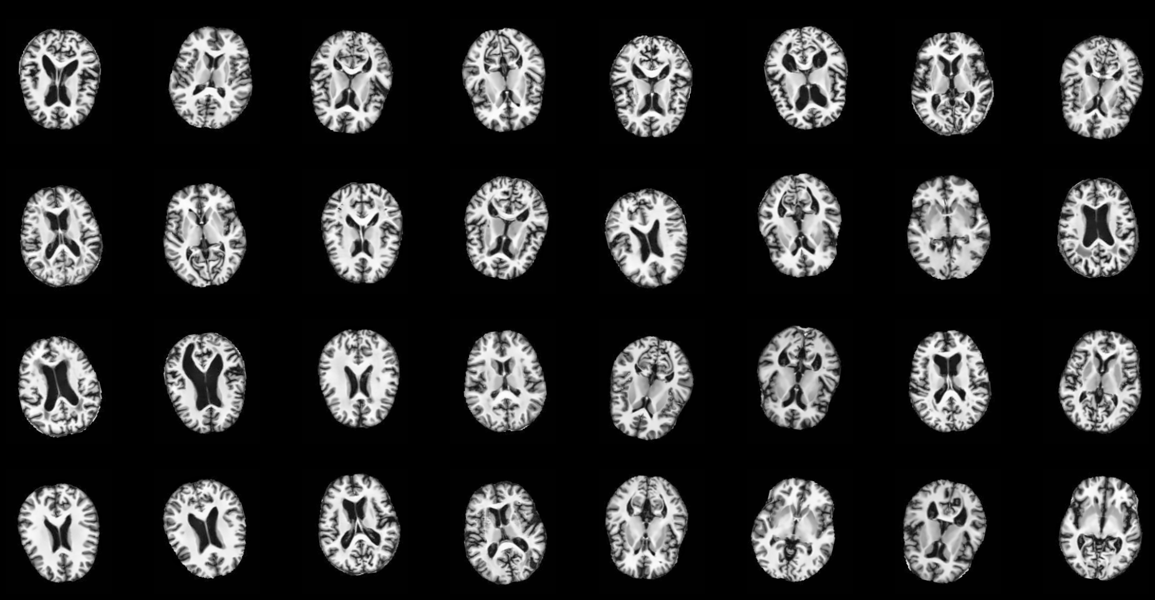
Data Augmentation
Notes:
And there you have it. 5000 augmented images ready to be fed into the model. Next, Zhenqi will talk about the actual model.

Slide 25
Preprocessing
Re-classification
Binarization
Contrast enhancement
Denoising
Intensity normalization
Notes:
To effectively detect Alzheimer's disease, MRI image preprocessing is crucial. As Alzheimer's disease is linked to specific brain changes, many of which are structural, preprocessing aims to enhance the model's ability to identify these changes. First, we re-classified the labels of the dataset to make them more suitable for our project.

Slide 26
Preprocessing
Re-classification
Binarization
Contrast enhancement
Denoising
Intensity normalization
Re-classification
Binarization
Notes:
To effectively detect Alzheimer's disease, MRI image preprocessing is crucial. As Alzheimer's disease is linked to specific brain changes, many of which are structural, preprocessing aims to enhance the model's ability to identify these changes. But first, let’s start with the most basic one – re-classification. The original dataset contains four classes of data points, namely non-demented, very mild demented, mild demented, and moderate demented. We re-classified them into a binary target variable, which contains demented and non-demented because our goal is to detect Alzheimer's disease rather than classifying the stages.

Slide 27
Preprocessing
Re-classification
Re-classification
Binarization
Contrast enhancement
Denoising
Intensity normalization
Binarization
Notes:
Next, we converted the MRI images into binary images to be used by the model. And this step is called binarization.

